Slide 1
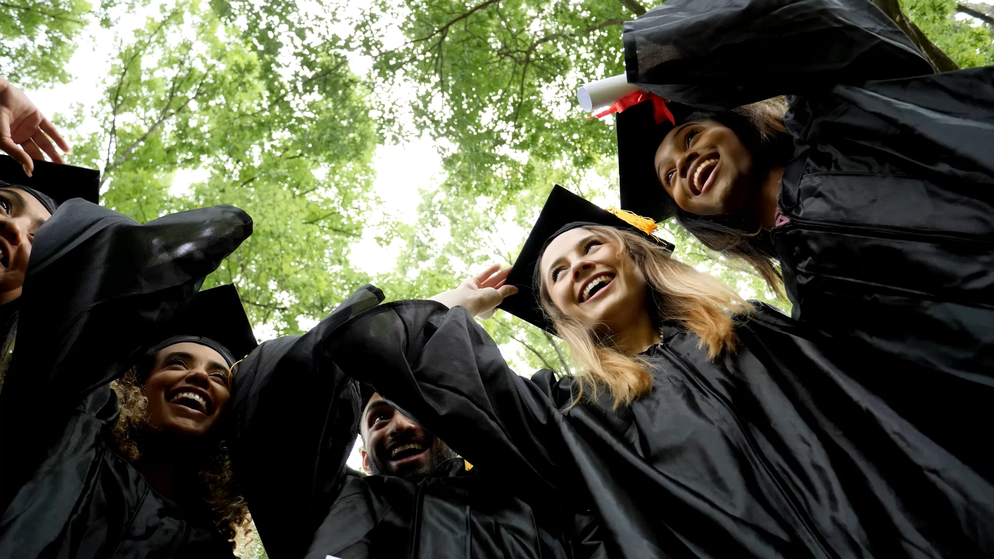
Class of 20xx
MOUNT FLORES COLLEGE

Slide 2

TOSS THE CAP
IT’S TIME TO

Slide 3

OUR GREATEST GLORY IS NOT IN NEVER FAILING, BUT IN RISING EVERY TIME WE FAIL.
- Confucius

Slide 4

FAR AND AWAY THE BEST PRIZE THAT LIFE OFFERs IS THE CHANCE TO WORK HARD AT WORK WORTH DOING.
- THEODORE ROOSEVELT

Slide 5

IF YOU WANT TO GO FAST, GO ALONE. IF YOU WANT TO GO FAR, GO TOGETHER.
- African Proverb

Slide 6

EDUCATION IS THE KINDLING OF A FLAME, NOT THE FILLING OF A VESSEL.
- SOCRATES

Slide 7

Congratulations!
On to the next adventure

